Slide 1

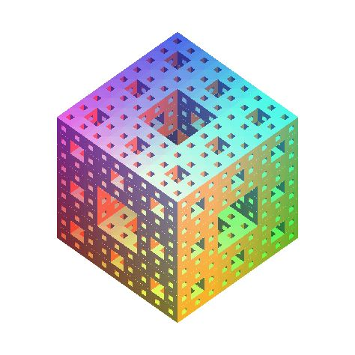
Adaptive Coding from a Diffusion
Process on the Integer Line
Robert Ellis
October 26, 2009
Joint work with Joshua Cooper,
University of South Carolina

Slide 2
Outline of Talk
2
Coding theory overview
  Packing (error-correcting) & covering codes
  Coding as a 2-player game
  Liar game and pathological liar game
Diffusion processes on Z
  Simple random walk (linear machine)
  Liar machine
  Pathological liar game, alternating question strategy
Improved pathological liar game bound
  Reduction to liar machine
  Discrepancy analysis of liar machine versus linear machine
Concluding remarks

Slide 3
Coding Theory Overview
3
Codewords:
fixed-length strings from a finite alphabet
Primary uses:
Error-correction for transmission in the presence of noise
Compression of data with or without loss
Viewpoints:
Packings and coverings of Hamming balls in the hypercube
2-player perfect information games
Applications:
Cell phones, compact disks, Mars Reconnaissance Orbiter

Slide 4
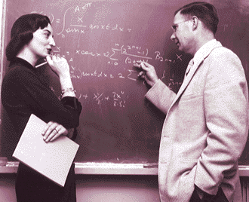
Coding Theory: (n,e)-Codes
4
Transmit blocks of length n
Noise changes
≤ e bits per block
(||η||₁ ≤ e)
Repetition code 111, 000
  length: n = 3
  e = 1
  information rate: 1/3
x₁…x_{n}
η
(x₁+η₁)…(x_{n}+ η_{n})
Richard Hamming
Received:
110
010
000
101
blockwise majority vote
Decoded:
111
000
000
111
Notes:
(After second bullet)
The Hamming assumption is that noise is “adversarial”; that is, an adversary may choose up to e bits to invert in the binary symmetric channel.
A code can be successful with high probability under the Shannon assumption (usually there is a unique decoding), but can fail under the Hamming assumption (there exists a situation with non-unique decoding).

Slide 5
Coding Theory – A Hamming (7,1)-Code
5
Length n=7, corrects e=1 error
received
1 | 0 | 0 | 0 | 1 | 1 | 1 |  | 0 | 1 | 1 | 0 | 1 | 1 | 0
0 | 1 | 0 | 0 | 0 | 1 | 1 |  | 0 | 1 | 0 | 1 | 1 | 0 | 1
0 | 0 | 1 | 0 | 1 | 0 | 1 |  | 0 | 0 | 1 | 1 | 0 | 1 | 1
0 | 0 | 0 | 1 | 1 | 1 | 0 |  | 1 | 1 | 1 | 0 | 0 | 0 | 1
0 | 0 | 0 | 0 | 0 | 0 | 0 |  | 1 | 1 | 0 | 1 | 0 | 1 | 0
1 | 1 | 0 | 0 | 1 | 0 | 0 |  | 1 | 0 | 1 | 1 | 1 | 0 | 0
1 | 0 | 1 | 0 | 0 | 1 | 0 |  | 0 | 1 | 1 | 1 | 0 | 0 | 0
1 | 0 | 0 | 1 | 0 | 0 | 1 |  | 1 | 1 | 1 | 1 | 1 | 1 | 1
1
1
0
1
0
0
1
1
0
0
1
0
0
1
1
1
0
0
1
0
0
decoded
3 errors: incorrect decoding
1 error: correct decoding
Notes:
Encoding and decoding is automated by using a codeword generator matrix and a decoding parity-check matrix.
The 3 right-most bits are parity-check bits. They are defined as the sum of the first 4 bits with the 2nd, 3rd, and 4th bits left out, respectively.

Slide 6
A Repetition Code as a Packing
6
(3,1)-code: 111, 000
Pairwise distance = 3 ➔
1 error can be corrected
The M codewords of an
(n,e)-code correspond to
a packing of Hamming balls
of radius e in the n-cube
111
111
110
101
011
110
101
011
100
010
001
100
010
001
000
000
A packing of 2
radius-1 Hamming balls
in the 3-cube
Notes:
((3,1)-repetition code)

Slide 7
A (5,1)-Packing Code as a 2-Player Game
7
(5,1)-code: 11111, 10100, 01010, 00001
Paul
Carole
11111
What is the 1st bit?
0
10100
What is the 2nd bit?
0
01010
What is the 3rd bit?
0
00001
What is the 4th bit?
1
0
1
>1
What is the 5th bit?
0
# errors
11111
11111
10100
01010
00001
01010
00001
00001
10100
01010
00001
00001
01111
00100
00100
00010
00010
00010
00010
00011
Notes:
Paul represents the receiver, waiting to get the bits of the message.
Carole is a combination of the sender and the noise. If we assume that Carole sends at most one error, we can track the possibility of each codeword being the intended message.
Because the (5,1)-code is a packing in the 5-cube, Paul is always able to eliminate all but at most one codeword from Carole’s answers.
(If he eliminates all codewords, Carole has defaulted (violated the bound on errors in the game).)
In this game, we say that Carole has “lied” once in the 2nd question about 01010 being the correct codeword.

Slide 8
Covering Codes
8
Covering is the companion problem to packing
Packing: (n,e)-code
Covering: (n,R)-code
111
111
110
101
011
110
101
011
packing radius
length
100
010
001
100
010
001
covering radius
000
000
(3,1)-packing code and
(3,1)-covering code
“perfect code”
11111
11111
00100
10100
01111
00010
01010
10111
00001
00001
11000
(5,1)-packing code
(5,1)-covering code
Notes:
By convention, coding theorists use e for the packing radius and R for the covering radius. For the rest of this talk, we assume e=R.
Hamming (n,1)-codes are perfect codes. They exist when the size of the Hamming ball divides the size of the n-cube.
There is no perfect (5,1)-code. This is because the 5-cube volume, 32, is not divisible by size of the radius 1 Hamming ball, 6.

Slide 9
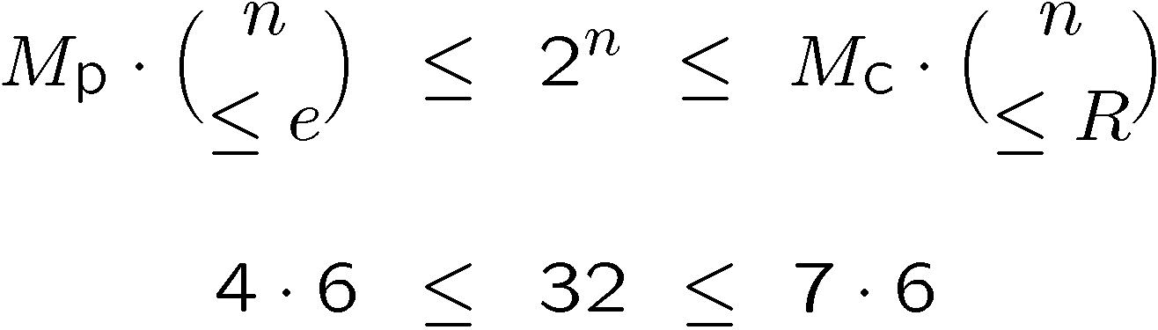
Optimal Length 5 Packing & Covering Codes
9
(5,1)-packing code
11111
11110
11101
11011
10111
01111
11100
11010
11001
10110
10101
10011
01110
01101
01011
00111
11000
10100
10010
10001
01100
01010
01001
00110
00101
00011
10000
01000
00100
00010
00001
(5,1)-covering code
11111
00000
11110
11101
11011
10111
01111
11100
11010
11001
10110
10101
10011
01110
01101
01011
00111
Sphere bound:
11000
10100
10010
10001
01100
01010
01001
00110
00101
00011
10000
01000
00100
00010
00001
00000
Notes:
These two codes can be proved optimal by exhaustive combinatorial analysis, though there more powerful techniques.
This packing code cannot be converted into an optimal covering code by the addition of Hamming balls. (It would take 4 more Hamming balls, as no three uncovered words are in the same ball.)
The optimal packing and covering code sizes bracket 2^n.

Slide 10
A (5,1)-Covering Code as a Football Pool
10
Round 1
Round 2
Round 3
Round 4
Round 5
Bet 1
W
W
W
W
W
11111
Bet 2
L
W
W
W
W
01111
Bet 3
W
L
W
W
W
10111
Bet 4
W
W
L
L
L
11000
Bet 5
L
L
W
L
L
00100
Bet 6
L
L
L
W
L
00010
Bet 7
L
L
L
L
W
00001
Payoff: a bet with ≤ 1 bad prediction
Question. Min # bets to guarantee a payoff?
Ans.=7
Notes:
Football means soccer!
5 rounds of football are played, each with outcome (W)in or (L)ose, with respect to the home team.
A bet is a set of predictions on each of the 5 rounds.
A payoff is made for a bet with at most 1 incorrect prediction.
The minimum number of best needed to guarantee a payoff is 7, because the problem is equivalent to finding an optimal (5,1)-covering code.
A Finnish magazine for soccer pools published one such code a couple of years before it was discovered by Swiss scientist Marcel J.E. Golay.
We can also view as a 2-player game, moving codewords to the right as they conflict with game results in rounds 1-5.

Slide 11

Codes with Feedback (Adaptive Codes)
11
Feedback
Noiseless, delay-less report of actual received bits
Improves the number of decodable messages
E.g., from 20 to 28 messages for an (8,1)-code
1, 0, 1, 1, 0
1, 1, 1, 1, 0
sender
receiver
Noise
1, 1, 1, 1, 0
Elwyn Berlekamp
Noiseless Feedback
Notes:
With feedback, the sender can adjust the transmission according to a pre-agreed strategy.
Codes employing feedback are called “adaptive codes”
Feedback does not help for n<=7 for packing codes.

Slide 12
A (5,1)-Adaptive Packing Code as a 2-Player Liar Game
12
Paul
Carole
Is the message C or D?
Y
A
B
Is the message A or C?
N
C
Is the message B?
N
D
Is the message D?
N
0
1
>1
Is the message C?
Y
# lies
Message
A
B
C
D
Original
encoding
00101
01110
01010
11000
10011
Adapted
encoding
101**
100**
1000*
1****
1****
10***
10***
1000*
11***
10001
10000
Y $ 1, N $ 0
Notes:
The question “Is the message C or D” corresponds to the first bit of the codewords for C and D being 1, and for those of A and B being 0.
Carole’s first response of “Y” corresponds to transmitting the first bit as 1.
Now Paul knows the original encoding of A and B will not be completely successful, so he may adapt to a new strategy. His second question “Is the message A or C?” assigns a 1 to the second bit of A and C, and a 0 to the second bit of B and D. For A and B, this means in the second bit of the adapted encoding.

Slide 13
A (5,1)-Adaptive Covering Code as a Football Pool
13
Round 1
Round 2
Round 3
Round 4
Round 5
Bet 1
W
W
W
Bet 1
Bet 2
W
L
W
W
L
Bet 2
Bet 3
Bet 3
W
L
L
L
W
Bet 4
Bet 5
Bet 4
L
W
Bet 6
Bet 5
L
W
0
1
>1
Bet 6
L
W
# bad
predictions
(# lies)
Carole
W
L
L
W
L
Payoff: a bet with ≤ 1 bad prediction
Question. Min # bets to guarantee a payoff?
Ans.=6
Notes:
Now we consider companion problem in which Paul wants to guarantee that at least one message survives. This is in the same way that the covering code is the companion problem to the packing code.
We start with the football pool problem, but now allow the predictions of the bet to be filled out one-by-one, after the previous round has been played.
Carole adversarially supplies the outcome of the round, and tries to disqualify all of Paul’s bets.
In the second round, a bet with no bad predictions is worth more than a bet with a bad prediction. So the 1-2 split in the bets with 0 bad predictions is balanced by the 3-0 split in the bets with 1 bad prediction.
By allowing adaptivity in choosing predictions, the number of betting cards needed reduces from 7 to 6!

Slide 14
Optimal (5,1)-Codes
14
Code type | Optimal size
(5,1)-code | 4
(5,1)-adaptive code | 4
Sphere bound | 5 1/3
(5,1)-adaptive covering code | 6
(5,1)-covering code | 7

Slide 15
15
Linear Machine on Z
11
-9
-8
-7
-6
-5
-4
-3
-2
-1
0
1
2
3
4
5
6
7
8
9
Notes:
15

Slide 16
Linear Machine on Z
5.5
5.5
-9
-8
-7
-6
-5
-4
-3
-2
-1
0
1
2
3
4
5
6
7
8
9

Slide 17
Linear Machine on Z
2.75
5.5
2.75
-9
-8
-7
-6
-5
-4
-3
-2
-1
0
1
2
3
4
5
6
7
8
9
Time-evolution is proportional to rows of Pascal’s triangle

Slide 18
Liar Machine on Z
Liar machine time-step
Number chips left-to-right 1,2,3,…
Move odd chips right, even chips left
(Reassign numbers every time-step)
t=0
11 chips
-9
-8
-7
-6
-5
-4
-3
-2
-1
0
1
2
3
4
5
6
7
8
9

Slide 19
Liar Machine on Z
Liar machine time-step
Number chips left-to-right 1,2,3,…
Move odd chips right, even chips left
(Reassign numbers every time-step)
t=1
-9
-8
-7
-6
-5
-4
-3
-2
-1
0
1
2
3
4
5
6
7
8
9

Slide 20
Liar Machine on Z
Liar machine time-step
Number chips left-to-right 1,2,3,…
Move odd chips right, even chips left
(Reassign numbers every time-step)
t=2
-9
-8
-7
-6
-5
-4
-3
-2
-1
0
1
2
3
4
5
6
7
8
9

Slide 21
Liar Machine on Z
Liar machine time-step
Number chips left-to-right 1,2,3,…
Move odd chips right, even chips left
(Reassign numbers every time-step)
t=3
-9
-8
-7
-6
-5
-4
-3
-2
-1
0
1
2
3
4
5
6
7
8
9

Slide 22
Liar Machine on Z
Liar machine time-step
Number chips left-to-right 1,2,3,…
Move odd chips right, even chips left
(Reassign numbers every time-step)
t=4
-9
-8
-7
-6
-5
-4
-3
-2
-1
0
1
2
3
4
5
6
7
8
9

Slide 23
Liar Machine on Z
Liar machine time-step
Number chips left-to-right 1,2,3,…
Move odd chips right, even chips left
(Reassign numbers every time-step)
t=5
-9
-8
-7
-6
-5
-4
-3
-2
-1
0
1
2
3
4
5
6
7
8
9

Slide 24
Liar Machine on Z
Liar machine time-step
Number chips left-to-right 1,2,3,…
Move odd chips right, even chips left
(Reassign numbers every time-step)
t=6
-9
-8
-7
-6
-5
-4
-3
-2
-1
0
1
2
3
4
5
6
7
8
9

Slide 25
Liar Machine on Z
Liar machine time-step
Number chips left-to-right 1,2,3,…
Move odd chips right, even chips left
(Reassign numbers every time-step)
t=7
-9
-8
-7
-6
-5
-4
-3
-2
-1
0
1
2
3
4
5
6
7
8
9
Height of linear machine at t=7

Slide 26
(6,1)-Liar Game
Liar game time step
Paul bipartitions chips: green, purple
Carole moves one color to right
Paul’s goal: disqualify all but ≤1 chip after t=6 time steps
Paul bipartitions
t=0
Carole moves purple
9 chips
0
1
2
disqualified

Slide 27
(6,1)-Liar Game
Liar game time step
Paul bipartitions chips: green, purple
Carole moves one color to right
Paul’s goal: disqualify all but ≤1 chip after t=6 time steps
Paul bipartitions
t=1
Carole moves green
0
1
2
disqualified

Slide 28
(6,1)-Liar Game
Liar game time step
Paul bipartitions chips: green, purple
Carole moves one color to right
Paul’s goal: disqualify all but ≤1 chip after t=6 time steps
Paul bipartitions
t=2
Carole moves green
0
1
2
disqualified

Slide 29
(6,1)-Liar Game
Liar game time step
Paul bipartitions chips: green, purple
Carole moves one color to right
Paul’s goal: disqualify all but ≤1 chip after t=6 time steps
Paul bipartitions
t=3
Carole moves purple
0
1
2
disqualified

Slide 30
(6,1)-Liar Game
Liar game time step
Paul bipartitions chips: green, purple
Carole moves one color to right
Paul’s goal: disqualify all but ≤1 chip after t=6 time steps
Paul bipartitions
t=4
Carole moves purple
0
1
2
disqualified

Slide 31
(6,1)-Liar Game
Liar game time step
Paul bipartitions chips: green, purple
Carole moves one color to right
Paul’s goal: disqualify all but ≤1 chip after t=6 time steps
Paul bipartitions
t=5
Carole moves green
0
1
2
disqualified

Slide 32
(6,1)-Liar Game
Liar game time step
Paul bipartitions chips: green, purple
Carole moves one color to right
Paul’s goal: disqualify all but ≤1 chip after t=6 time steps
t=6
0
1
2
disqualified
Two chips survive: Paul loses

Slide 33
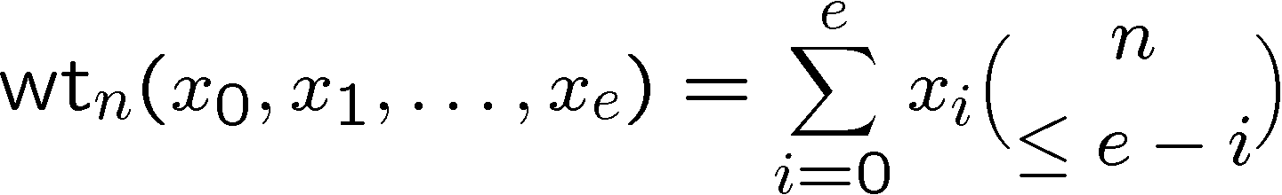
A Liar Game Strategy for Carole
33
Weight function for n rounds left; x_{i} = #chips with i lies:
Lemma (Berlekamp)
Refined sphere bound
Liar game. Carole keeps half of weight every step.
Initial weight > 2^{n} ) Final weight >1 ) Carole wins.
Pathological variant. Carole reduces half of weight every step.
Initial weight < 2^{n} ) Final weight <1 ) Carole wins.

Slide 34
(6,1)-Pathological Liar Game
Paul’s goal: preserve ¸ 1 chip after t=6 time steps
wt_{6-t}(x)=wt₆(x)=2⁶-1
Paul bipartitions
t=0
Carole moves green
9 chips
0
1
2
disqualified

Slide 35
(6,1)-Pathological Liar Game
Paul’s goal: preserve ¸ 1 chip after t=6 time steps
wt₅(x)=2⁵-3
Paul bipartitions
t=1
Carole moves green
0
1
2
disqualified

Slide 36
(6,1)-Pathological Liar Game
Paul’s goal: preserve ¸ 1 chip after t=6 time steps
wt₄(x)=2⁴-2
Paul bipartitions
t=2
Carole moves green
0
1
2
disqualified

Slide 37
(6,1)-Pathological Liar Game
Paul’s goal: preserve ¸ 1 chip after t=6 time steps
wt₃(x)=2³-1
Paul bipartitions
t=3
Carole moves purple
0
1
2
disqualified

Slide 38
(6,1)-Pathological Liar Game
Paul’s goal: preserve ¸ 1 chip after t=6 time steps
wt₂(x)=2²-1
Paul bipartitions
t=4
Carole moves purple
0
1
2
disqualified

Slide 39
(6,1)-Pathological Liar Game
Paul’s goal: preserve ¸ 1 chip after t=6 time steps
wt₁(x)=2¹-1
Carole moves green
t=5
Paul bipartitions
0
1
2
disqualified

Slide 40
(6,1)-Pathological Liar Game
Paul’s goal: preserve ¸ 1 chip after t=6 time steps
wt₀(x)=2⁰-1<1
t=6
0
1
2
disqualified
No chips survive: Paul loses

Slide 41
Optimal (6,1)-Codes
41
Code type | Optimal #chips
(6,1)-code | 8
(6,1)-adaptive code (Liar game) | 8
Sphere bound | 9 1/7
(6,1)-adaptive covering code (Pathological liar game) | 10
(6,1)-covering code | 12

Slide 42
New Approach to the Pathological Liar Game
42
Spencer and Winkler (`92) reduced the liar game to the liar machine, a discrete diffusion process on the integer line.
Ellis and Yan (`04) introduced the pathological liar game.
Cooper and Spencer (`06) use discrepancy analysis to compare the Propp-machine to simple random walk on Z^{d}.
Here: (1) We reduce the pathological liar game to the liar machine,
(2) Use discrepancy analysis to compare the liar machine to simple random walk on Z, and thereby
(3) Improve the best known pathological liar game strategy when the number of lies is a constant fraction of the number of rounds.

Slide 43
Liar Machine vs. Pathological Liar Game
43
9 chips
-9
-8
-7
-6
-5
-4
-3
-2
-1
0
1
2
3
4
5
6
7
8
9
t=0
9 chips
-9
-8
-7
-6
-5
-4
-3
-2
-1
0
1
2
3
4
5
6
7
8
9
disqualified

Slide 44
Liar Machine vs. Pathological Liar Game
44
-9
-8
-7
-6
-5
-4
-3
-2
-1
0
1
2
3
4
5
6
7
8
9
t=1
-9
-8
-7
-6
-5
-4
-3
-2
-1
0
1
2
3
4
5
6
7
8
9
disqualified

Slide 45
Liar Machine vs. Pathological Liar Game
45
-9
-8
-7
-6
-5
-4
-3
-2
-1
0
1
2
3
4
5
6
7
8
9
t=2
-9
-8
-7
-6
-5
-4
-3
-2
-1
0
1
2
3
4
5
6
7
8
9
disqualified

Slide 46
Liar Machine vs. Pathological Liar Game
46
-9
-8
-7
-6
-5
-4
-3
-2
-1
0
1
2
3
4
5
6
7
8
9
t=3
-9
-8
-7
-6
-5
-4
-3
-2
-1
0
1
2
3
4
5
6
7
8
9
disqualified

Slide 47
Liar Machine vs. Pathological Liar Game
47
-9
-8
-7
-6
-5
-4
-3
-2
-1
0
1
2
3
4
5
6
7
8
9
t=4
-9
-8
-7
-6
-5
-4
-3
-2
-1
0
1
2
3
4
5
6
7
8
9
disqualified

Slide 48
Liar Machine vs. Pathological Liar Game
48
-9
-8
-7
-6
-5
-4
-3
-2
-1
0
1
2
3
4
5
6
7
8
9
t=5
-9
-8
-7
-6
-5
-4
-3
-2
-1
0
1
2
3
4
5
6
7
8
9
disqualified

Slide 49
Liar Machine vs. Pathological Liar Game
49
-9
-8
-7
-6
-5
-4
-3
-2
-1
0
1
2
3
4
5
6
7
8
9
t=6
No chips survive: Paul loses
-9
-8
-7
-6
-5
-4
-3
-2
-1
0
1
2
3
4
5
6
7
8
9
disqualified

Slide 50
(6,1)-Pathological Liar Game, Liar Machine
50
Code type | Optimal #chips
Sphere bound | 9 1/7
(6,1)-adaptive covering code (Pathological liar game) | 10
(6,1)-liar machine | 12
(6,1)-liar machine optimum: Minimum number of initial chips for ¸ 1 chip to be at position · -4 when t=6
-9
-8
-7
-6
-5
-4
-3
-2
-1
0
1
2
3
4
5
6
7
8
9
disqualified
(6,1)-Liar machine started with 12 chips after 6 rounds

Slide 51
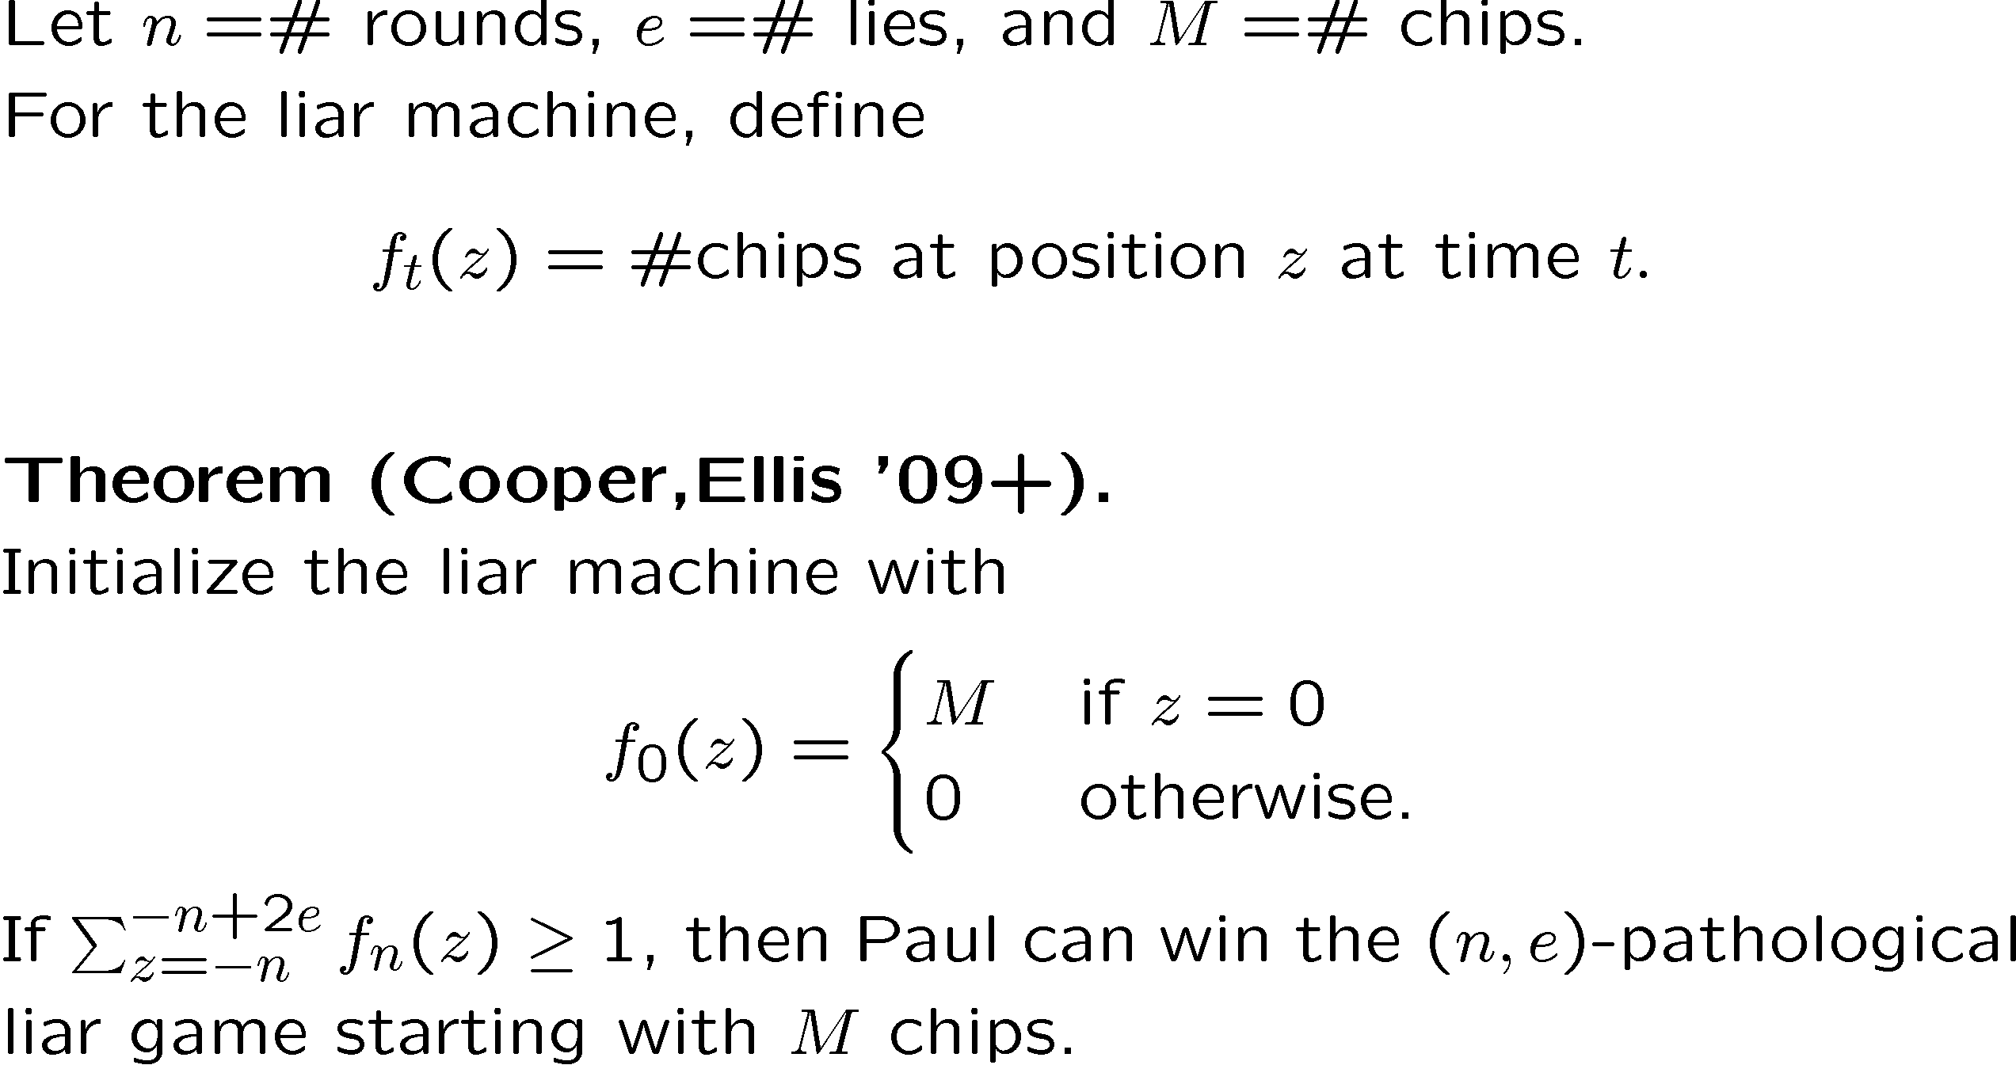
Reduction to Liar Machine
Notes:
\documentclass{slides}\pagestyle{empty}
\usepackage{amsmath,multirow,amssymb}
\usepackage[usenames]{color}
\setlength{\textwidth}{8.5in}
\newcommand{\E}{\mathrm{E}} \newcommand{\R}{\mathcal{R}}
\renewcommand{\P}{\mathrm{P}} \newcommand{\ho}{H}
\newcommand{\h}{\widetilde{H}} \newcommand{\V}{\mathrm{Var}}
\newcommand{\Gnp}{\mathcal{G}(n,p)} \newcommand{\SigM}{\hat{\Sigma}_{\mathrm{R}}(H)}
\newcommand{\HCoreSG}[3]{\mathcal{H}_{#2,#3}(#1)}
\newcommand{\SRep}[2]{\mathcal{S}_{#2}(#1)}
\begin{document}
Let $n=$\# rounds, $e=$\# lies, and $M=$\# chips.\\
For the liar machine, define
$$
f_t(z) = \mbox{\#chips at position $z$ at time $t$}.
$$
{\bf Theorem (Cooper,Ellis '09+).}\\
Initialize the liar machine with
$$
f_0(z) = \begin{cases} M & \mbox{if $z=0$}\\ 0 & \mbox{otherwise.}\end{cases}
$$
If $\sum_{z=-n}^{-n+2e}f_n(z)\geq 1$,
then Paul can win the $(n,e)$-pathological liar game
starting with $M$ chips.
\end{document}

Slide 52
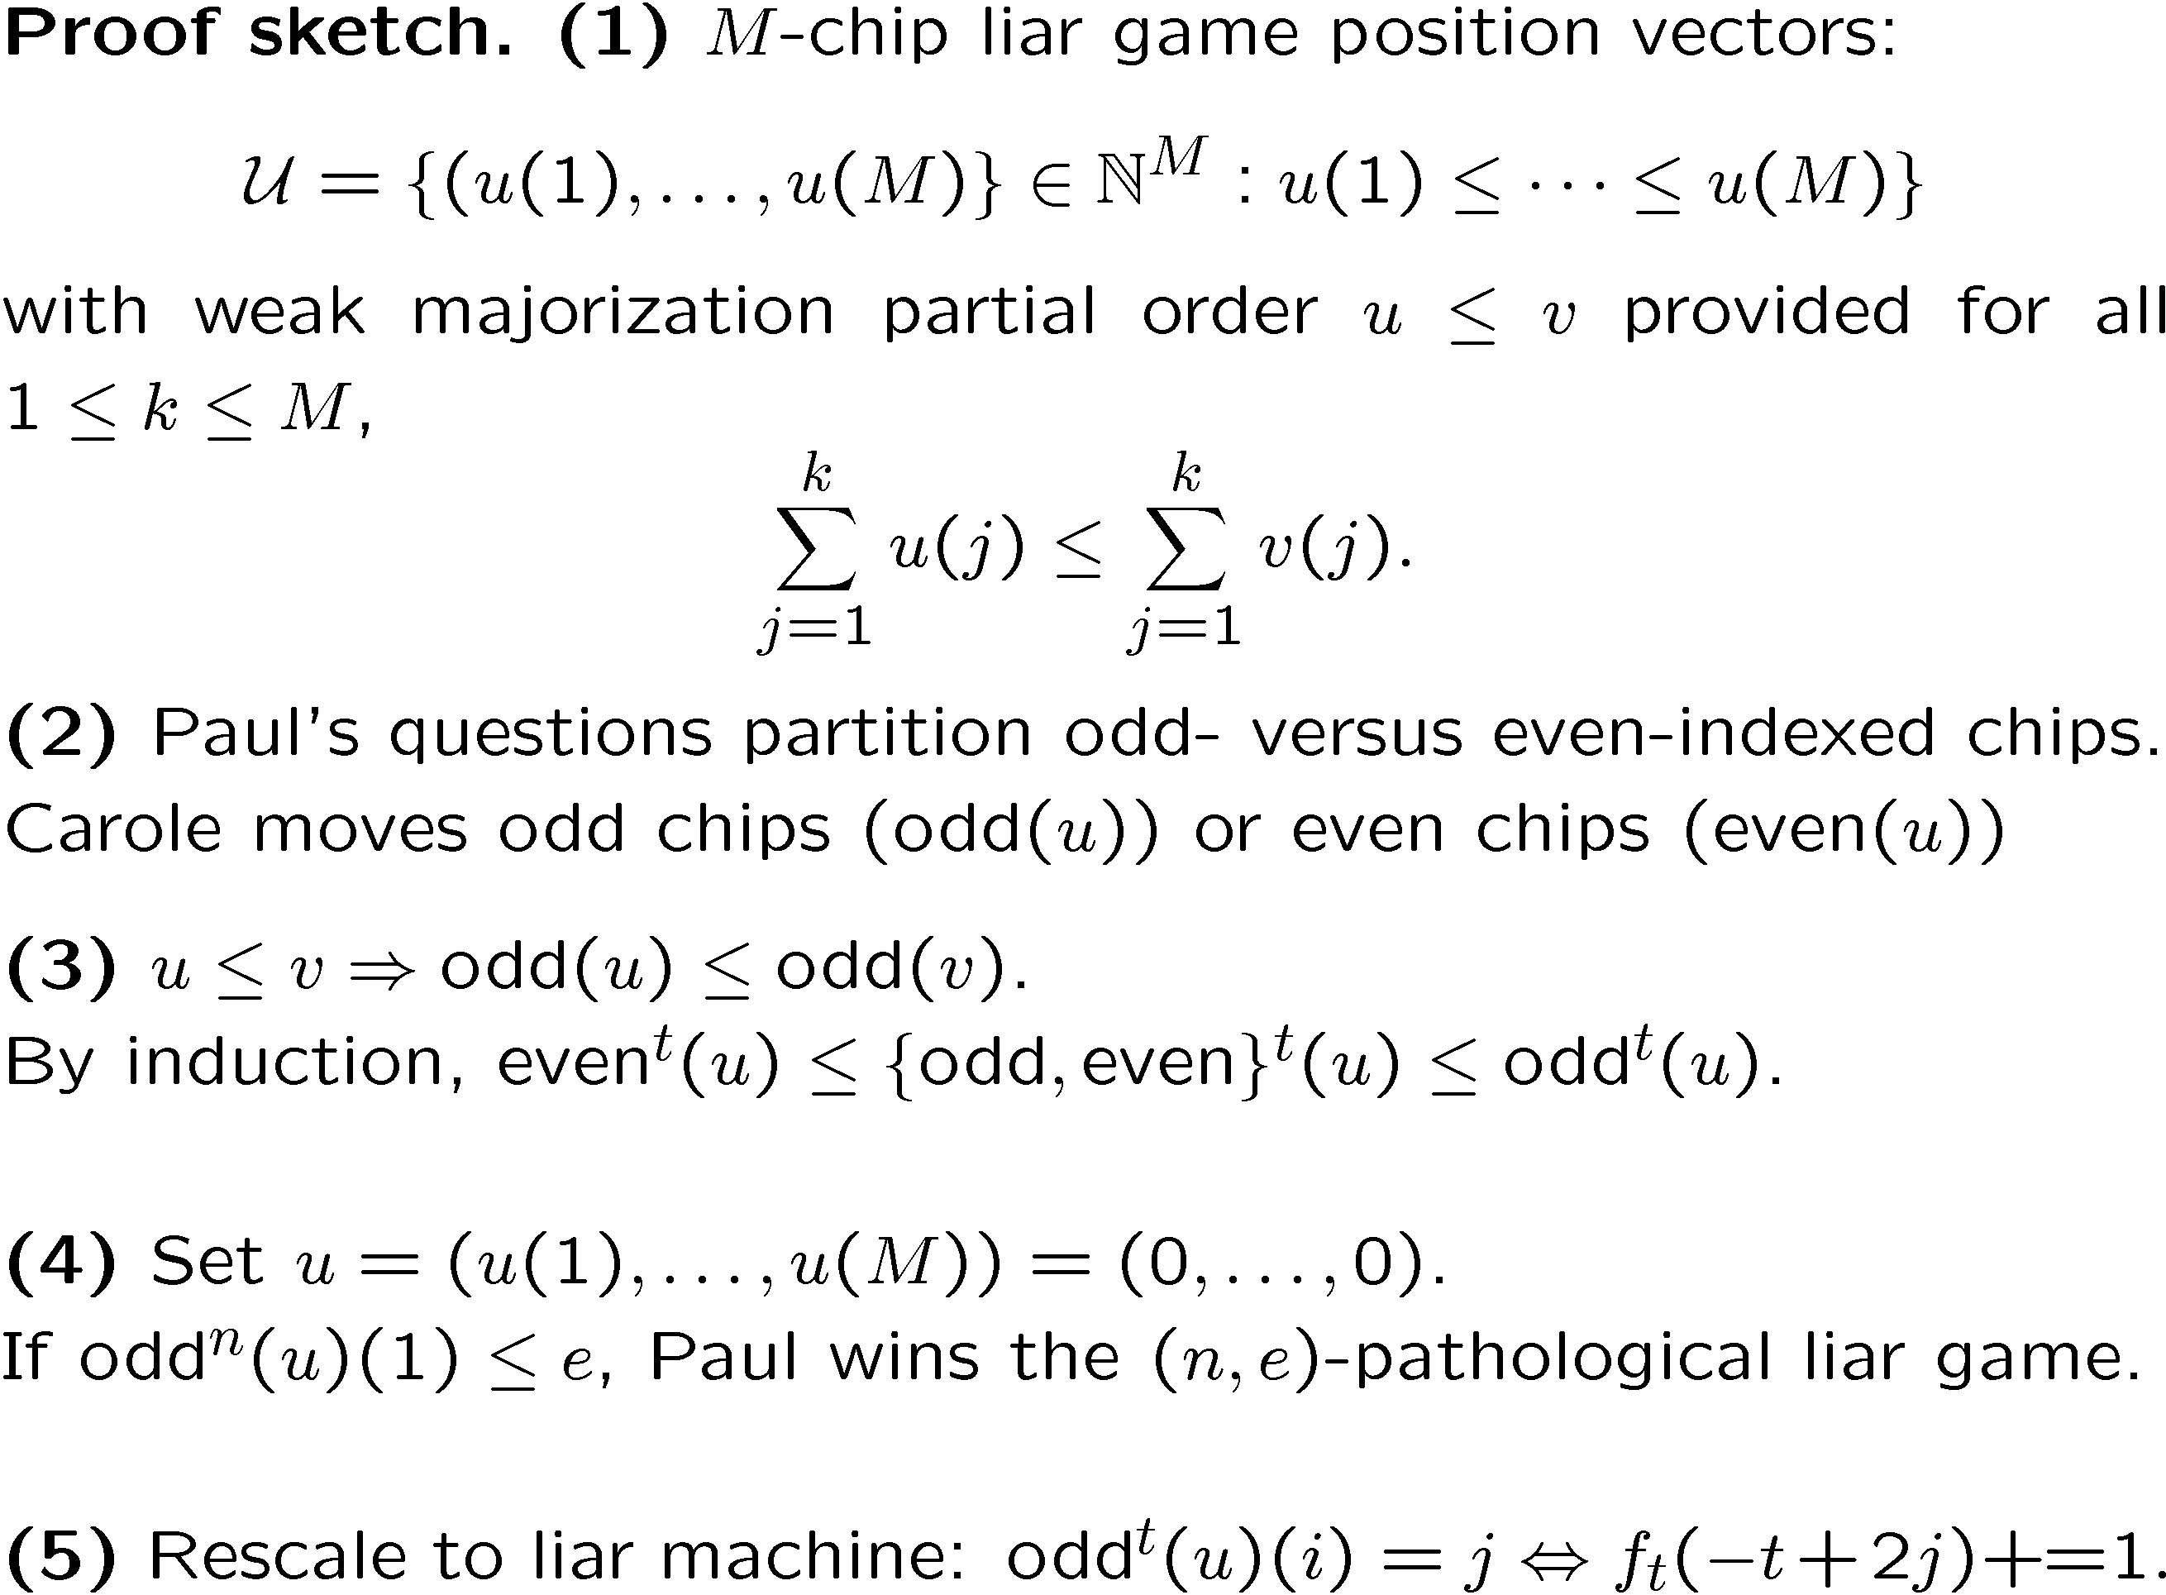
Reduction to Liar Machine
Notes:
\documentclass{slides}\pagestyle{empty}
\usepackage{amsmath,multirow,amssymb}
\usepackage[usenames]{color}
\setlength{\textwidth}{8.75in}
\newcommand{\E}{\mathrm{E}} \newcommand{\R}{\mathcal{R}}
\renewcommand{\P}{\mathrm{P}} \newcommand{\ho}{H}
\newcommand{\h}{\widetilde{H}} \newcommand{\V}{\mathrm{Var}}
\newcommand{\Gnp}{\mathcal{G}(n,p)} \newcommand{\SigM}{\hat{\Sigma}_{\mathrm{R}}(H)}
\newcommand{\HCoreSG}[3]{\mathcal{H}_{#2,#3}(#1)}
\newcommand{\SRep}[2]{\mathcal{S}_{#2}(#1)}
\begin{document}
{\bf Proof sketch.} {\bf (1)} $M$-chip
liar game position vectors:
$$\mathcal{U} = \{(u(1),\ldots,u(M)\}\in \mathbb{N}^M:u(1)\leq \cdots\leq u(M)\}$$
with weak majorization partial order $u\leq v$ provided for all
$1\leq k\leq M$, \vspace{-.15in}
$$\sum_{j=1}^k u(j)\leq \sum_{j=1}^k v(j).$$
{\bf (2)} Paul's questions partition odd- versus even-indexed chips.\\
Carole moves odd chips ($\textsc{odd}(u)$) or even chips ($\textsc{even}(u)$)
\vspace{-.25in}
{\bf (3)} $u\leq v\Rightarrow \textsc{odd}(u)\leq \textsc{odd}(v)$.\\
By induction,
$\textsc{even}^t(u)\leq \{\textsc{odd},\textsc{even}\}^t(u)\leq \textsc{odd}^t(u)$.
{\bf (4)} Set $u=(u(1),\ldots,u(M))=(0,\ldots,0)$.\\
If $\textsc{odd}^n(u)\leq e$, Paul wins the $(n,e)$-pathological liar game.
{\bf (5)} Rescale to liar machine: $\textsc{odd}^t(u)(i)=j \Leftrightarrow
f_t(-t+2j){\small+\!\!=}1.$
\end{document}

Slide 53
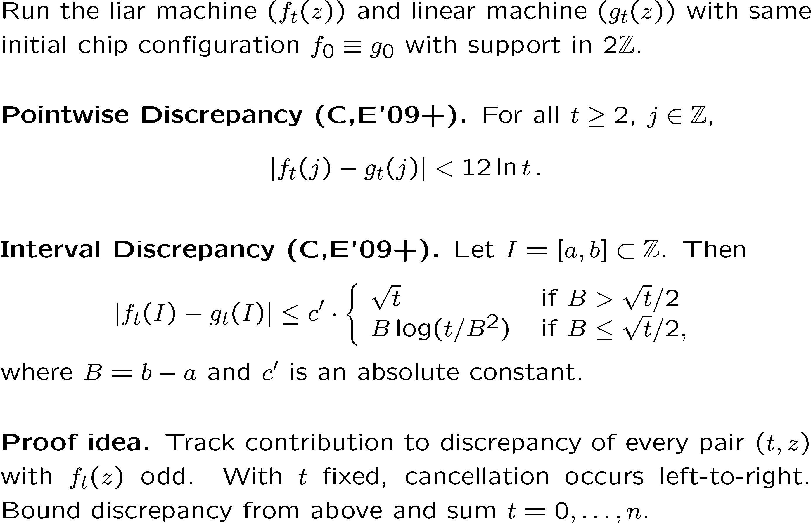
Liar Machine Versus Linear Machine

Slide 54











Saving One Chip in the Liar Machine
54

Slide 55
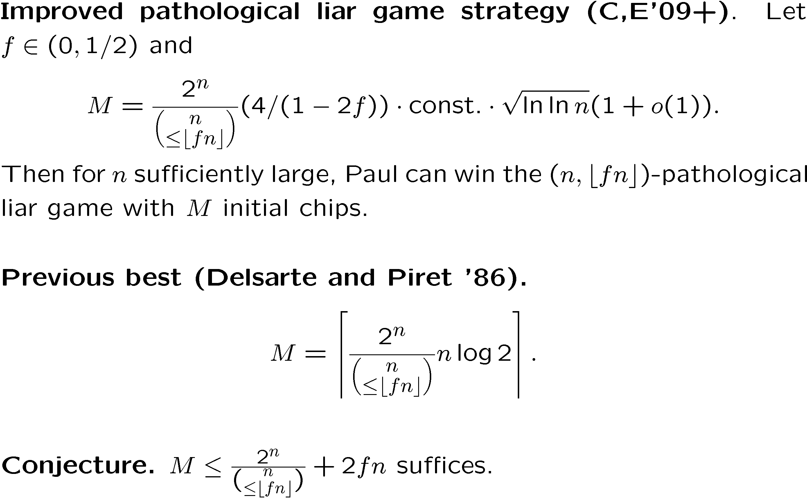
Pathological Liar Game Theorem

Slide 56
Further Exploration
56
Tighten the discrepancy analysis for the special case of initial chip configuration f₀(z)=M δ₀(z).
Generalize from binary questions to q-ary questions, q ¸ 2.
Improve analysis of the original liar game from Spencer and Winkler `92.
Prove general pointwise and interval discrepancy theorems for various discretizations of random walks.

Slide 57
Reading List
57
This paper: Linearly bounded liars, adaptive covering codes, and deterministic random walks, preprint (see homepage).
The liar machine
  Joel Spencer and Peter Winkler. Three thresholds for a liar. Combin. Probab. Comput.,1(1):81-93, 1992.
The pathological liar game
  Robert Ellis, Vadim Ponomarenko, and Catherine Yan. The Renyi-Ulam pathological liar game with a fixed number of lies. J. Combin. Theory Ser. A, 112(2):328-336, 2005.
Discrepancy of deterministic random walks
  Joshua Cooper and Joel Spencer, Simulating a Random Walk with Constant Error, Combinatorics, Probability, and Computing, 15 (2006), no. 06, 815-822.
  Joshua Cooper, Benjamin Doerr, Joel Spencer, and Gabor Tardos. Deterministic random walks on the integers. European J. Combin., 28(8):2072-2090, 2007.

