Slide 1
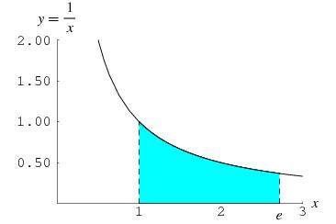
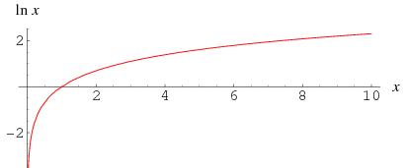
Properties of the natural log
Definition. For all x>0:
Properties:
Limits:
Definition of e:
Derivatives:
(Plots from Wolfram Alpha)

Slide 2
Tan(x), Logarithmic Differentiation
Steps in Logarithmic Differentiation
Take natural logarithm of both sides of an equation y = f(x) and use the Laws of Logarithms to simplify.
Differentiate implicitly with respect to x.
Solve the resulting equation for y’`.

